Slide 1
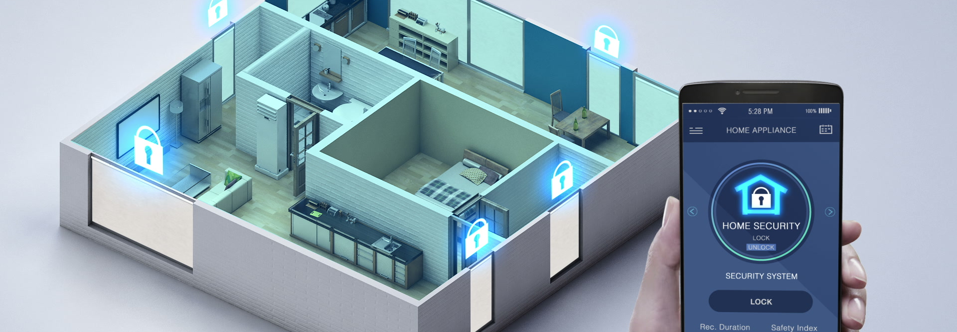
IoT GSM Smart Fire Control System
Supervised by:
Dr./ Amani Abdo
Presented by: Esraa Fahmi

Slide 2
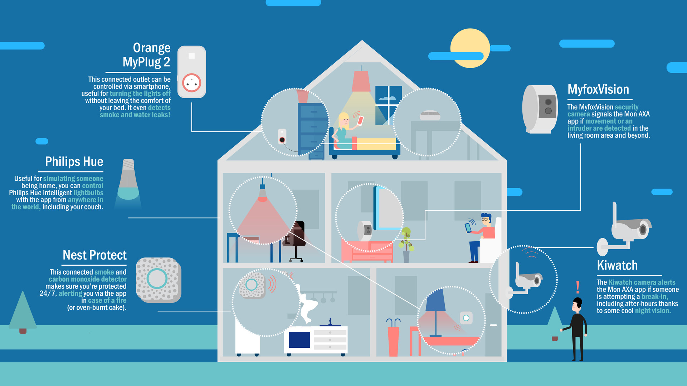
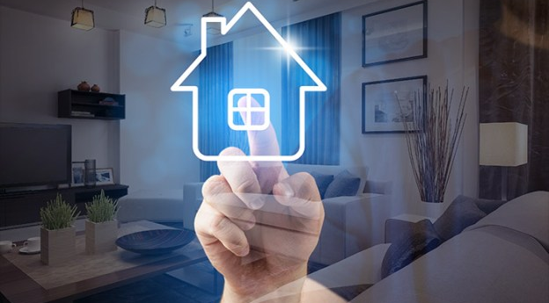
Agenda
Project Idea
Problem Definition
Project Objectives
Related Work 1,2,3
Gantt Chart
Functional Requirements
Non-Functional Requirements
Use Case Diagram
Data Flow Diagram
PCB Schematic
PCB Layout
Suggested Solution
Implementation
Goals Achieved
Results
Future Work
Conclusion

Slide 3
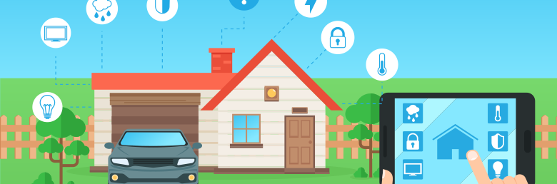
Project Idea
Reduce or even eliminate home natural disasters, such as Fire!
This can be achieved by developing a complete IoT solution for detecting and reporting incidents to users remotely.

Slide 4
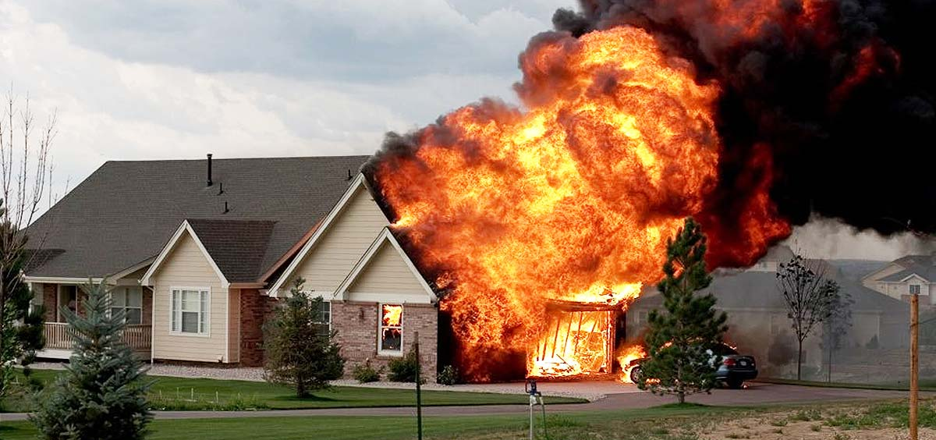
All natural and physical dangers that occur in homes, such as fire incidents!
Problem Definition

Slide 5
Project Objectives
Objective 1
Remotely secure homes from natural disasters.
Objective 2
Easily monitor the safety and security statuses of homes in a real-time manner.
Objective 3
Speed up the reaction process in case of susceptible security breaches or safety problems.
Objective 4
Ensure that all safety and security precautions are achieved.

Slide 6
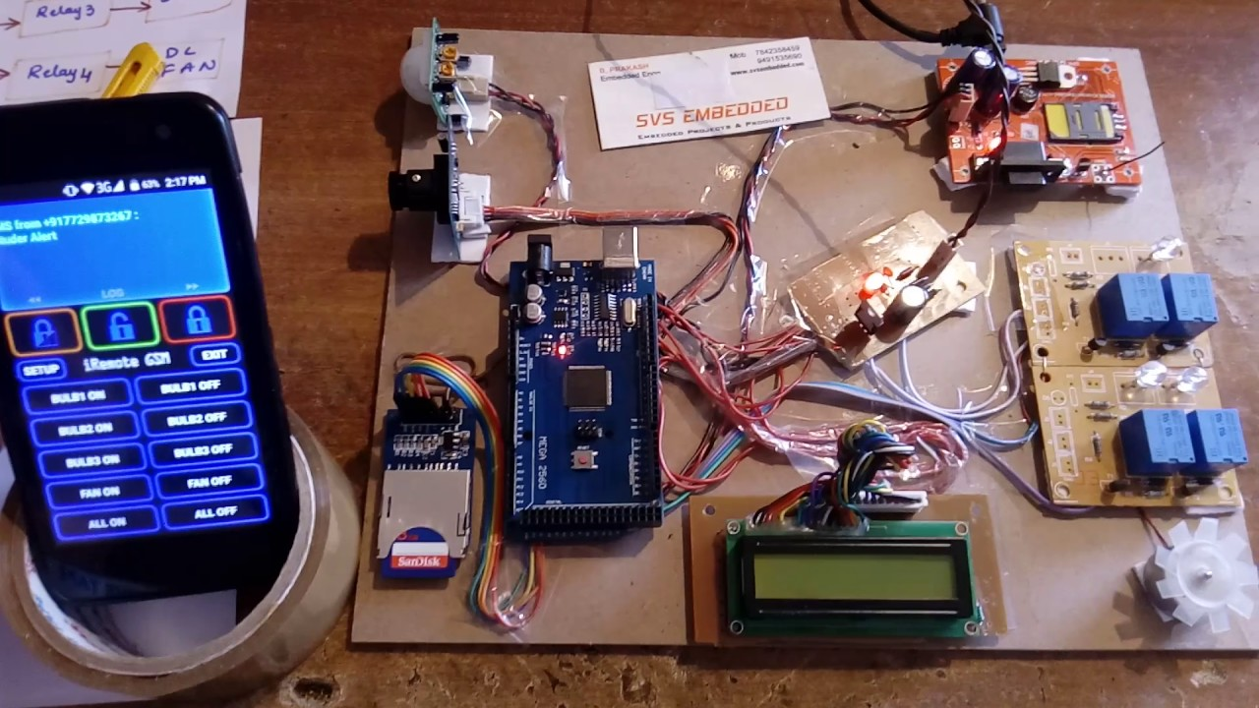
Related Work 1
Pros:
Wireless communication through GSM network.
SMS warning messages are supported.
Cons:
No Printed Circuit Board is manufactured.
Not all sensors are detectors are available.

Slide 7
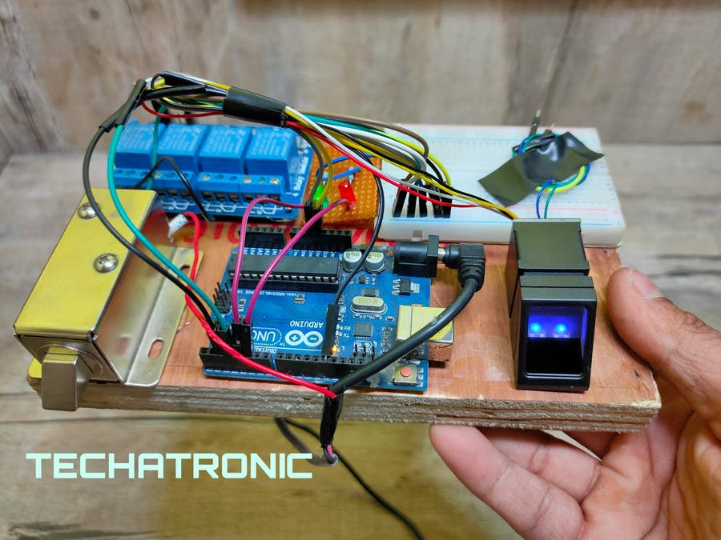
Related Work 2
Pros:
Real-time notifications via IoT mobile platform.
Cons:
No PCB is manufactured.
Access security is only supported.

Slide 8
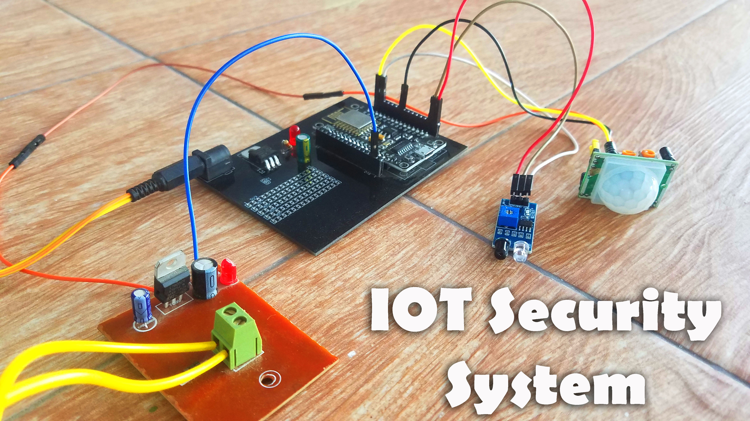
Related Work 3
Pros:
Wi-Fi communication technology is supported.
Easy to use and deploy.
Cons:
Not all sensors and detectors are supported.
No alarm siren is attached.

Slide 9
Functional Requirements
Connecting to Internet.
Disconnecting from Internet.
Connecting to Blynk IoT Cloud server.
Disconnecting from Blynk IoT Cloud server.
Reconnecting to Blynk IoT Cloud server.
Read IR sensor.
Read smoke sensor.
Read flame sensor.
Read motion sensor.
Calibrate read data from sensors.
Send data to software system.
Visualize incoming data.
Send mobile notifications.
Send email notifications.
Create user account.
Login with existent user account.
Reset user account password.
Receive authentication codes.

Slide 10
Non-Functional Requirements
Connection to Internet should not exceed 10 seconds.
Disconnection from Internet should be checked every 5 seconds.
Connection to Blynk IoT server should not exceed 15 seconds.
Disconnection from Blynk IoT server should be ignored for just 5 seconds.
Real-time communication should be maintained.
Timed data sending should be maintained.
Each sensor data should be calibrated before sending.
Mean time between failures should not exceed 2 in a month.
Mean time to failures should not exceed 1 in a week.
Mean time to repair should not exceed a quarter hour.
Periodic maintenance should be performed every month.
User email should be restricted on alphanumeric, hyphens and dots only.
User password length should be between 6 and 15.
User password should not contain spaces.
User password can be uncovered by only the entering user.

Slide 11
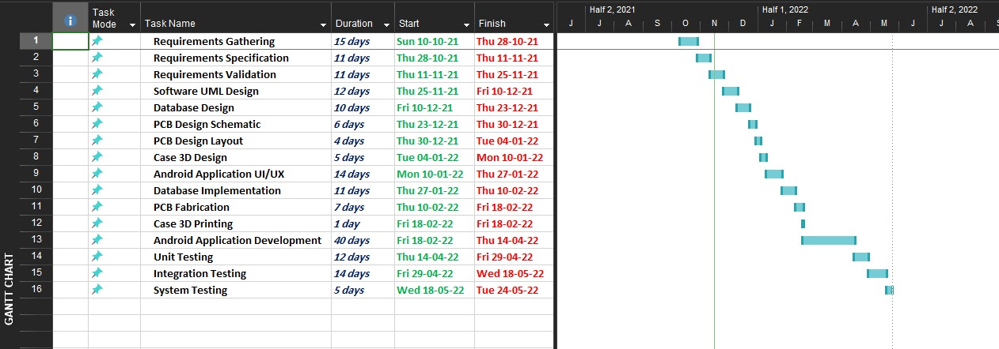
Gantt Chart

Slide 12
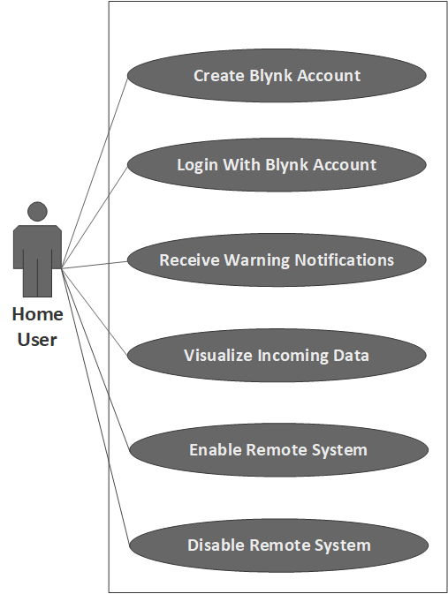
Use Case Diagram

Slide 13
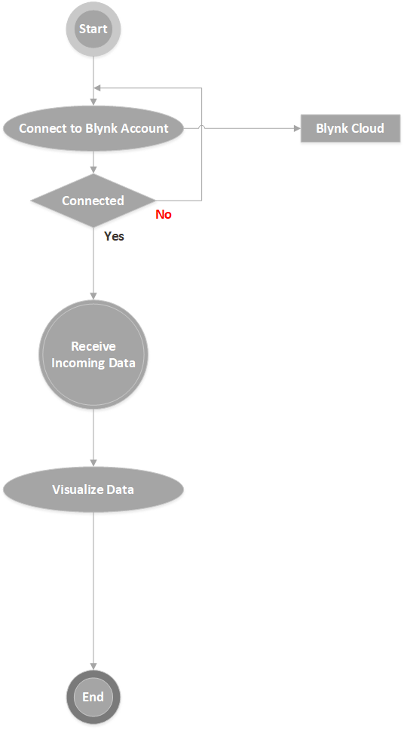
Data Flow Diagram

Slide 14
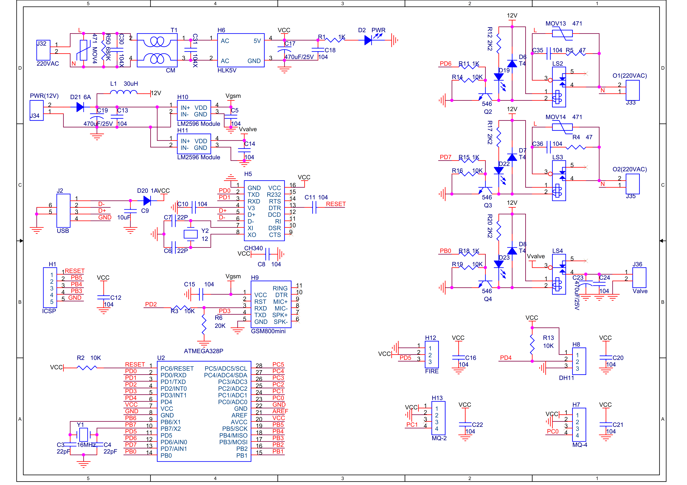
PCB Schematic

Slide 15
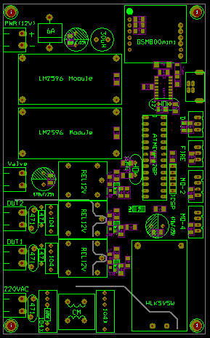
PCB Layout

Slide 16
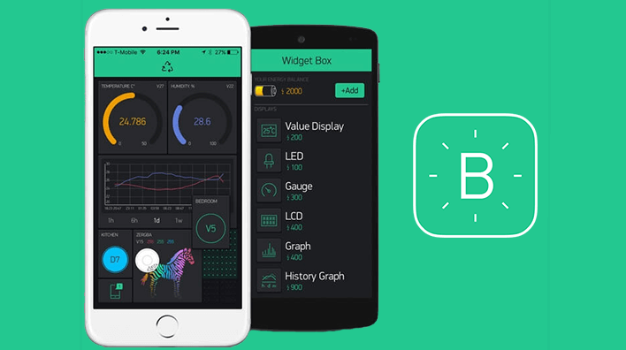
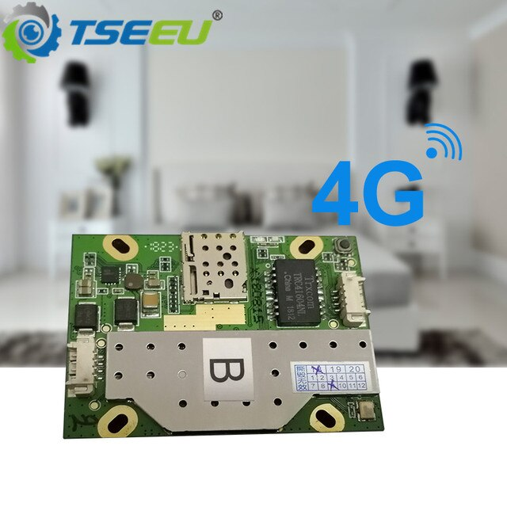
Suggested Solution
Cloud

Slide 17
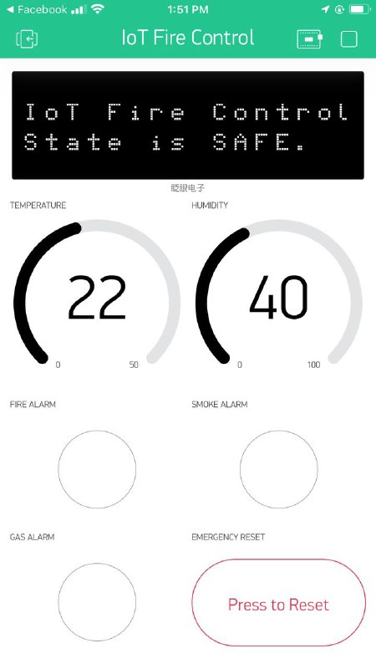
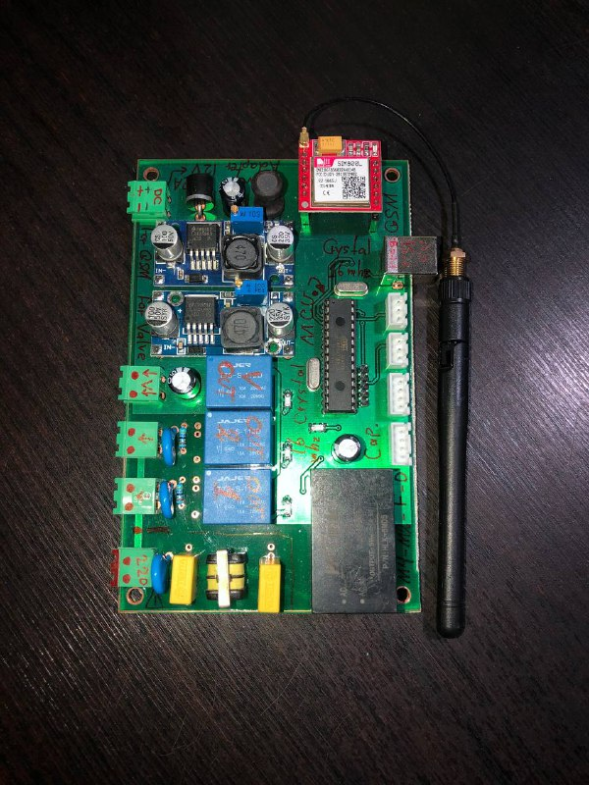
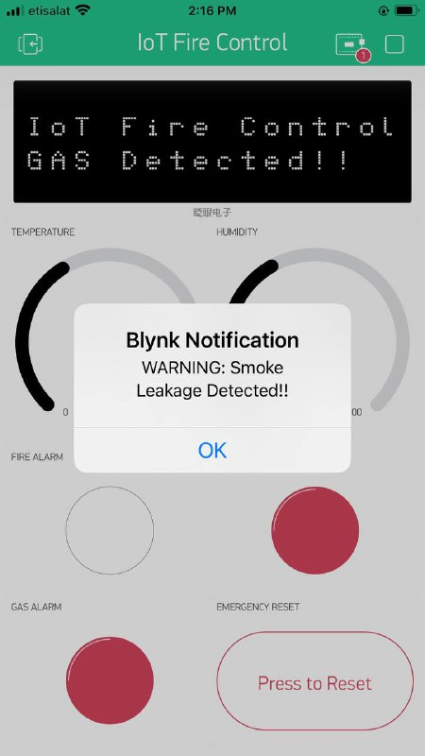
Implementation
Remotely Control system
PCB
Blynk Warning Notifications

Slide 18
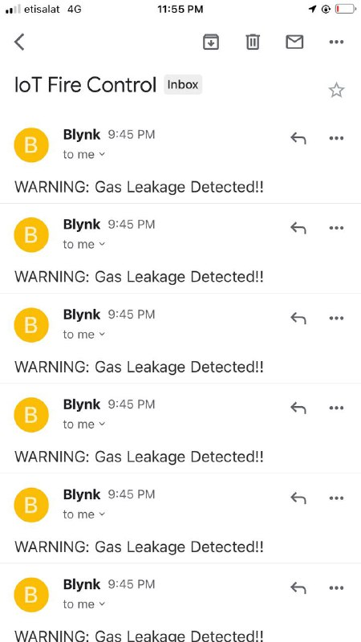
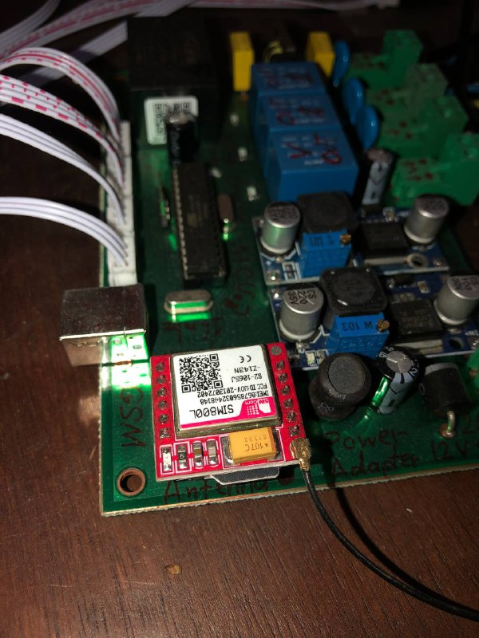
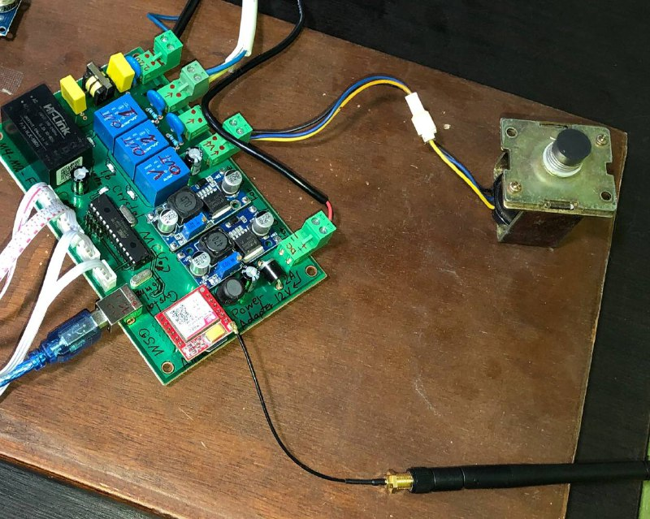
Implementation
Gmail Notifactions
GSM with Orange Internet
Automatically Gas Valve

Slide 19
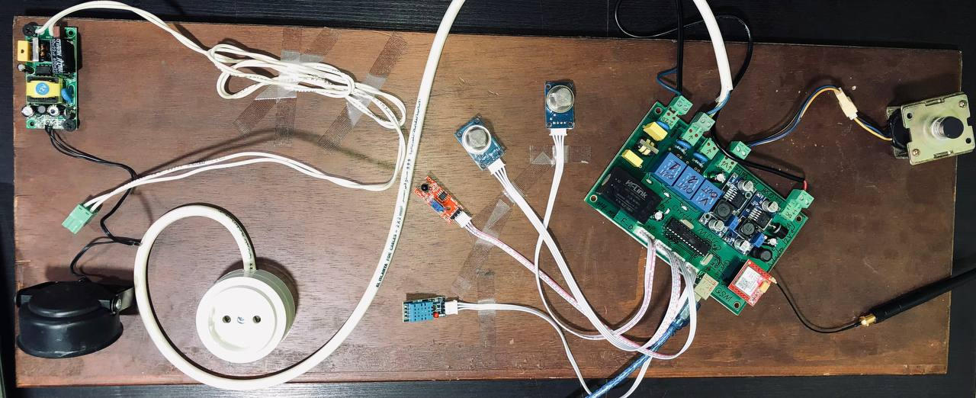
Implementation

Slide 20
Goals Achieved
Remotely securing houses from theft and breach incidents.
Easily monitoring the safety and security statues of houses in a real-time manner.
Speeding up the reaction process in case of susceptible security breaches or safety problems.
Ensuring that all safety and security precautions are strict and valid.
Enabling wireless ubiquitous communication for remote supervision.
All this goals have been successfully achieved during the project implementation period.

Slide 21
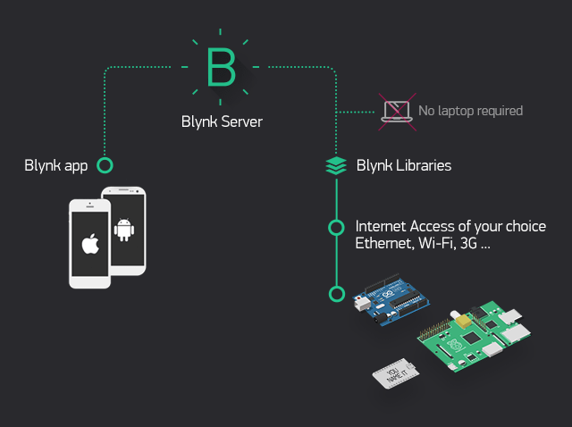
Results
Blynk App:
It allows to you create amazing interfaces for your projects using various widgets we provide.
Blynk Server:
It is responsible for all the communications between the smartphone and hardware. You can use our Blynk Cloud or run your private Blynk server locally. It’s open-source, could easily handle thousands of devices and can even be launched on a Raspberry Pi.
Blynk Libraries:
There are for all the popular hardware platforms - enable communication with the server and process all the incoming and outcoming commands.

Slide 22
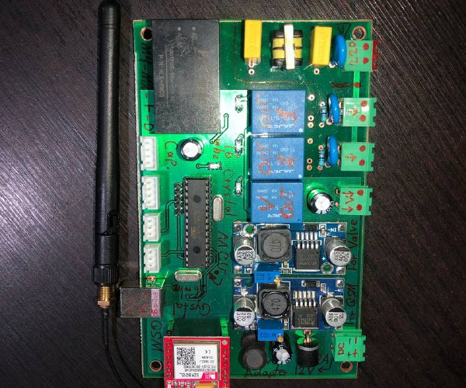
The printed circuit board (PCB) acts as the linchpin for almost all of today’s modern electronics. If the device needs to do some sort of computation — such as is the case even with simple items like a digital clock — chances are there’s a PCB inside of it. PCBs bring electronics to life by routing electrical signals where they need to go to satisfy all the device’s electronic requirements. For this to happen, PCBs are laid with a network of paths outlined in the traces. It’s these copper pathways that allow PCBs to direct electrical currents around their surface.
Results

Slide 23
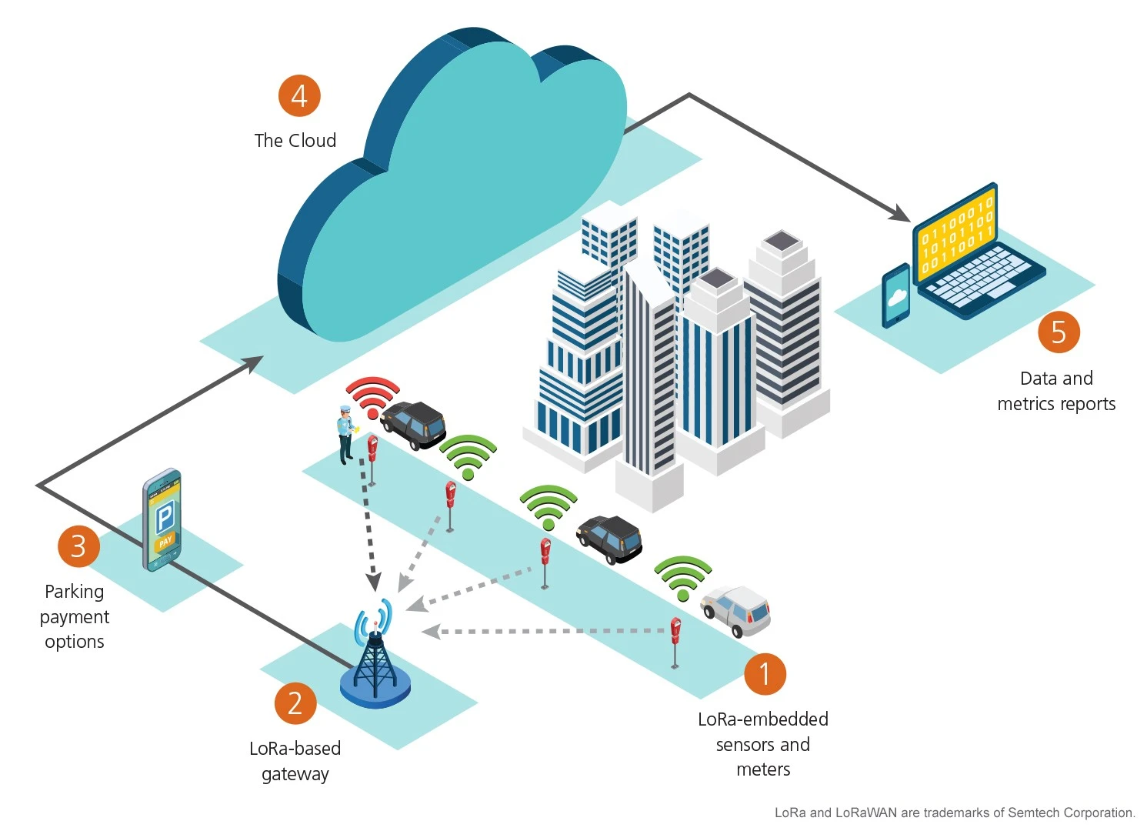
Future Work
Supporting web platform.
Deploying LoRa technology for long-range wireless communication.
Adding smart surveillance Wi-Fi camera.
Sending Location to FireFighting.

Slide 24
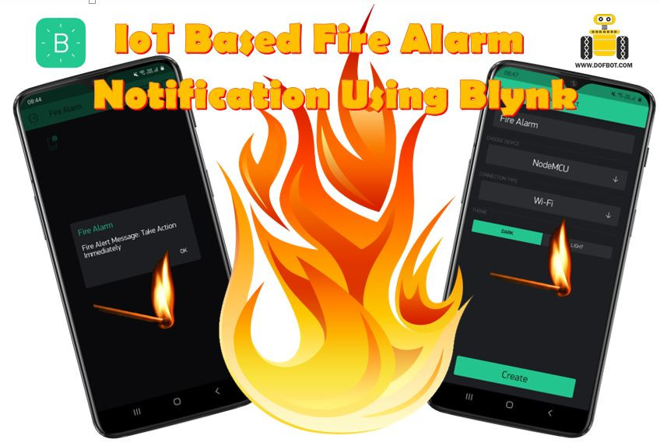
Eco-friendly shop security system developed by combining two systems, namely home-security system based on microcontrollers and monitoring system based on Android/iOS smartphone. The home security system is developed by using six types of security modules while monitoring system is developed by using advanced sensors, GSM technology “SIM800L mini” module, Blynk IoT and Android/iOS smartphone. This integrated system can detect both internal and external disturbances with excellent performance. This is proven by the excellent results of security module performance test and network connectivity test. The monitoring system also works well which is indicated by the success rate of notification sending and successful monitoring application run on Android/iOS smartphone. The next system will be developed for home security systems on cluster housing using LoRaWAN technology.
Conclusion

Slide 25
Thank You
Esraa

